Slide 1
Sect 5.2 Graphing with phase shifts, Vertical Expansions & Compressions
© Copyright all rights reserved to Homework depot: www.BCMath.ca

Slide 2
In this Section, we will look at how the following constants “A”, “B”, “C” and “D” will transform a Sine and Cosine Function
Constant “A”:
Vertical Expansion or Vertical Compression
The constant “A” gives us the “Amplitude” of the wave function
IF “A” is negative, there will be a Vertical Reflection
Constant “C”:
Horizontal SHIFT to the LEFT or RIGHT
Graph is shifted 3 units to the RIGHT
Constant “D”:
Vertical SHIFT to UP or DOWN

Slide 3
Ex: Indicate the values of “A”, “B”, “C” and “D” for each function. Then indicate the Amplitude and the transformations involved. Indicate the Domain and Range
A = 4 , so Amplitude is 4
A = -3 , so Amplitude is 3. There is also a VERTICAL Reflection!
C is “2” graph is shifted 2 units to the RIGHT
C is “-3” graph is shifted 3 units to the LEFT
D is “-3” graph is shifted 3 units DOWN
Domain is all real numbers
D is “8” graph is shifted 8 units UP
Range is from -7 to 1
Domain is all real numbers
Range is from 5 to 11

Slide 4
I) Review:
Indicate the transformations for each of the following equation:
V.E. by a factor of 3
H.S. 2 units right
V.S. 4 units up
V.E. by a factor of 2
and V.R.
H.S. 3 units left
H.C. by a factor of ½
H.S. 3 units right
© Copyright all rights reserved to Homework depot: www.BCMath.ca

Slide 5
III) INSRUCTIONS for Graphing Trigonometric Functions
Step 1: Use the constant “d” (vertical shift) to find the middle line
Step 2: Use the amplitude to find the highest points & lowest points of the graph
S3: Use the constant “C” (horizontal shift) to find out where the graph begins
S4: Use the Period to find out how long one cycle is
S5: Map out the period from the starting point and divide it into 4 sub-domains
y
4
2
x
0
0.5π
π
1.5π
2π
2.5π
3π
3.5π
4π
4.5π
5π
© Copyright all rights reserved to Homework depot: www.BCMath.ca

Slide 6
Practice: FIND the values of “A,B,C, & D”, then indicate all the transformations involved. Graph the function:
a) State the period and amplitude of the functions
b) Find the Y-intercept
c) State the domain and range

Slide 7
EX: Graph the following function and indicate the domain, range, amplitude, and period
y
1
x
−π
0
π
2π
3π
4π
5π
6π
7π
-1
-2
-3
-4
-5
-6
-7
© Copyright all rights reserved to Homework depot: www.BCMath.ca

Slide 8
Practice: Graph the following function and indicate the domain, range, Y-intercept, amplitude, and period
y
9
8
7
6
5
4
3
2
1
−π
0
π
2π
3π
4π
x
© Copyright all rights reserved to Homework depot: www.BCMath.ca

Slide 9
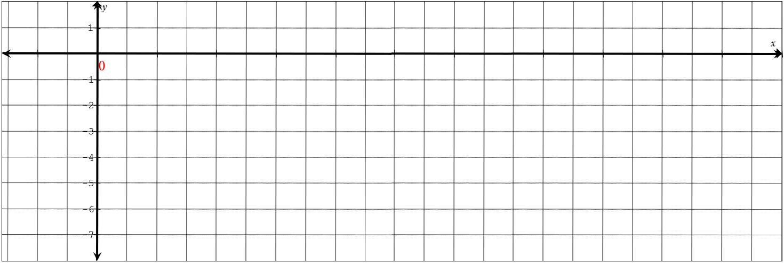
What to do when the increments are NOT labeled or given??

Slide 10
Ex: Given the following graph, find the values of A, B, C, and D for:
y
7
6
5
4
3
2
1
x
0
π
2π
3π
4π
-1
© Copyright all rights reserved to Homework depot: www.BCMath.ca

Slide 11
Ex: Indicate which of the following equation is the correct one for the graph
3
y
2
1
x
−π
0
π
2π
3π
-1
First find the vertical displacement “D”
© Copyright all rights reserved to Homework depot: www.BCMath.ca

Slide 12
Given the cosine function, which of the following is the correct Range?
The Vertical Displacement (Middle Line)
is “S”
The Amplitude is “R”
y
x
The Range is then between
“S - R” and “S + R”
© Copyright all rights reserved to Homework depot: www.BCMath.ca

Slide 13
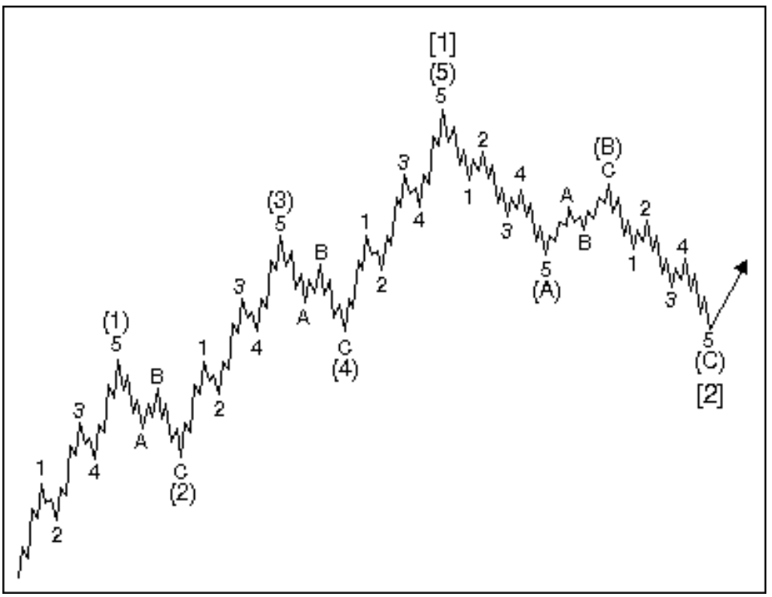
Elliot Waves:
https://www.investmenttheory.org/uploads/3/4/8/2/34825752/elliott-wave-principle.pdf

Slide 14
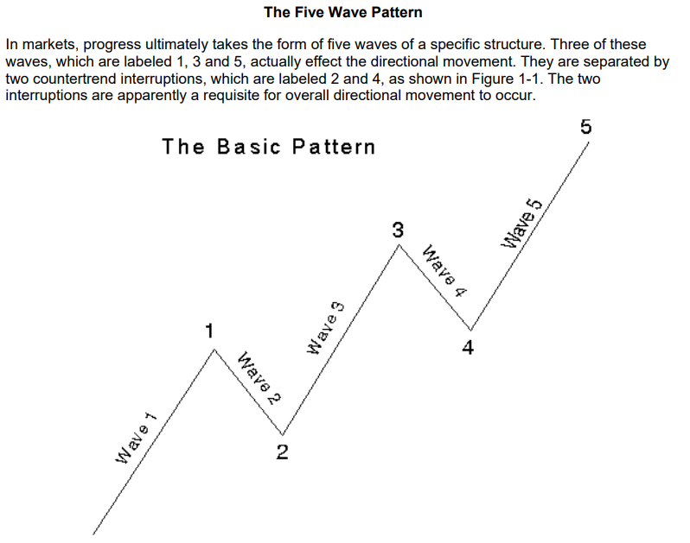

Slide 15
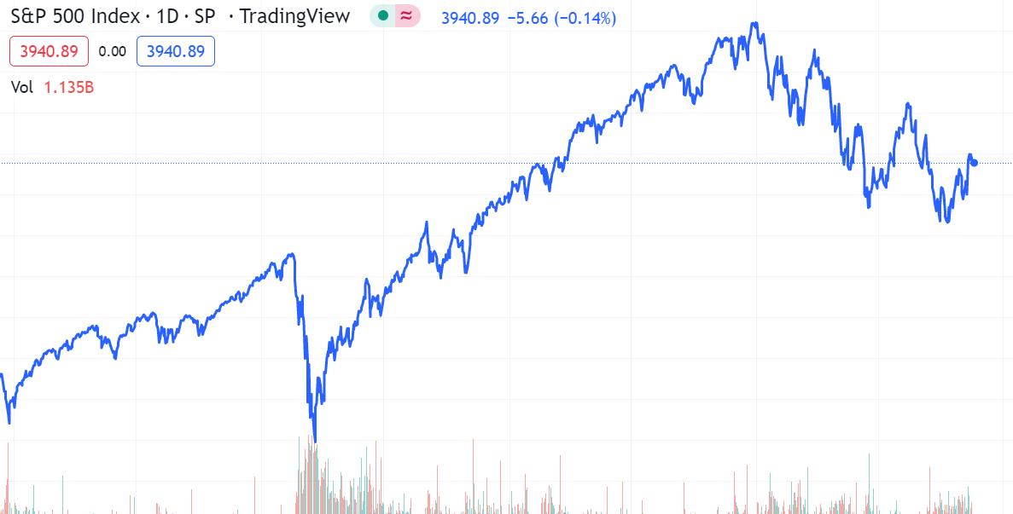

Slide 16


Slide 17
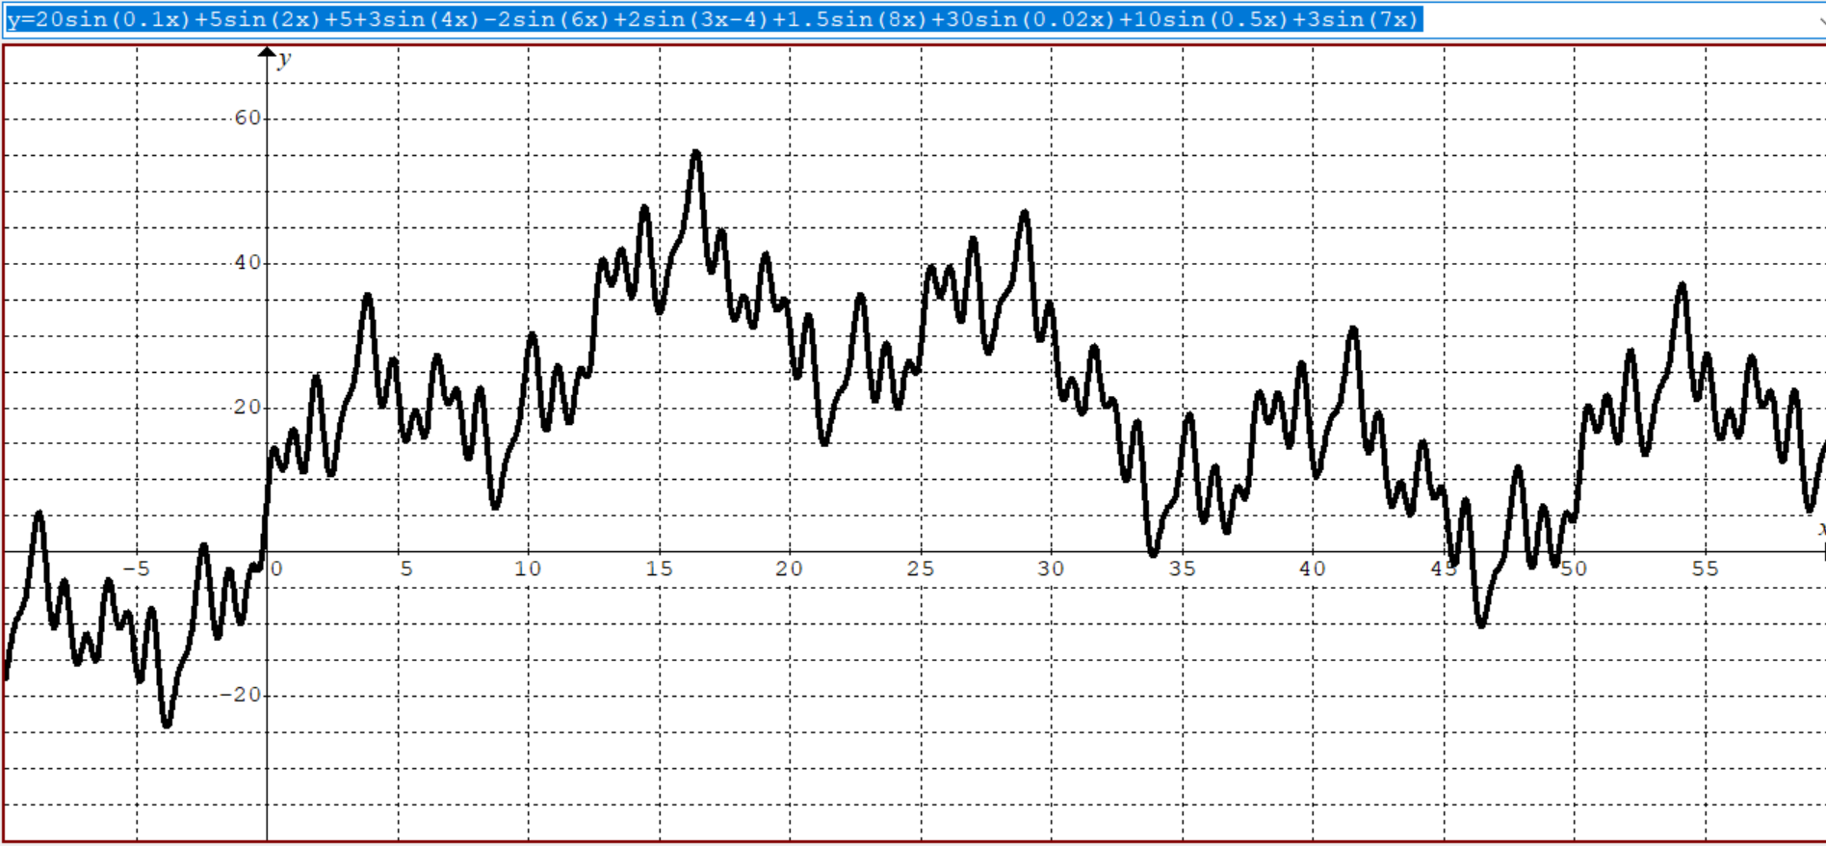

Slide 18
